Slide 1
New Branch Farms Event Venue
WHERE CASUAL MEETS ELEGANCE

Slide 2
New Branch Farms Event Venue Smithfield, VA

Slide 3
Opportunity
The United States wedding industry is worth $58 Billion
In 2016, 18,000 couples within a 1 ½ hour radius of Smithfield:
Spent an average of $30,000 on their wedding
Generating total sales of $438 million
Spending $51 million on the event venue alone
Local Event Venues are booking over 1 year in advance
* Statistics from the
2016 Wedding Report

Slide 4
Solution
New Branch Farms will offer a casually elegant venue with all the modern conveniences a bride and groom are looking for:
23 acres of wooded and open farmland
Climate controlled 3,300 sf hall with 2,700 sf of supporting space including a Gathering Area, Bridal Suite, Groom Room, Caterer's Kitchen, and ADA Restrooms
Several beautiful outdoor ceremony sites to choose from
State of the art technology throughout
The perfect marriage of indoor/outdoor opportunities all season long!

Slide 5
Market
Our primary market is newly engaged couples but our services also include:
Family Reunions
Birthday Parties
Anniversary Parties
Business Meetings
Staff Retreats
Company Picnics
Holiday Parties
Community Meetings
Social Gatherings
And more

Slide 6
Added Opportunity
In addition to event services, New Branch Farms offers The Photographer's Playground; a large area on the grounds of New Branch Farms that contains various photography settings. Brides, grooms, and anyone with a camera will love the variety of unique settings we offer: swings, chairs, lemonade stands, bathtubs, American flag walls, abstract walls, flower walls, picture frame walls, tents, and much, much more. Seasonally changed for year round opportunity.
The Photographer's Playground is a photographer's dream come true!

Slide 7
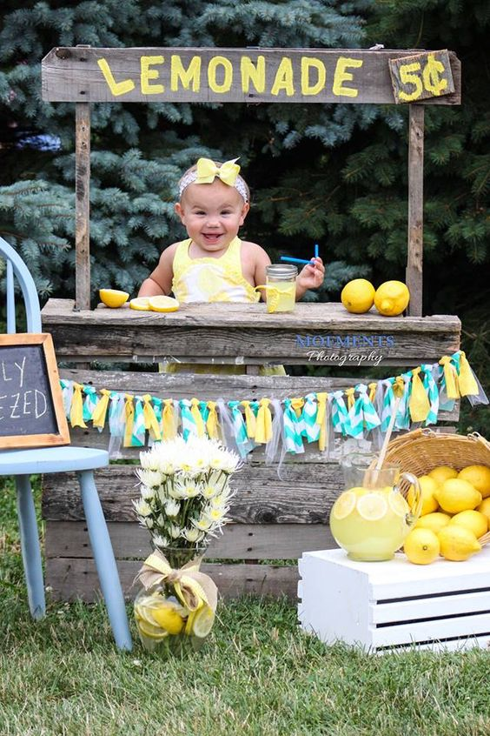
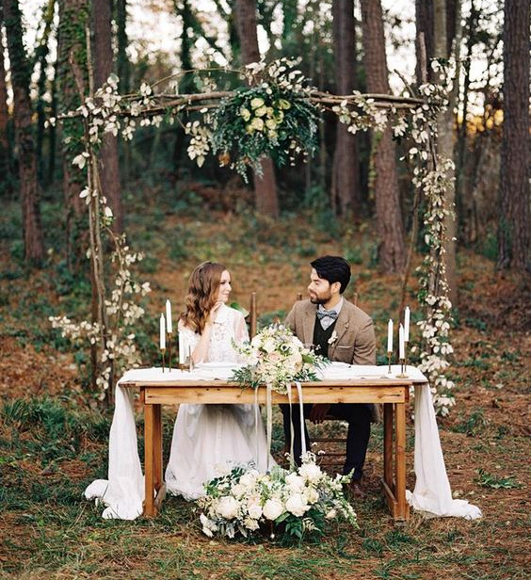
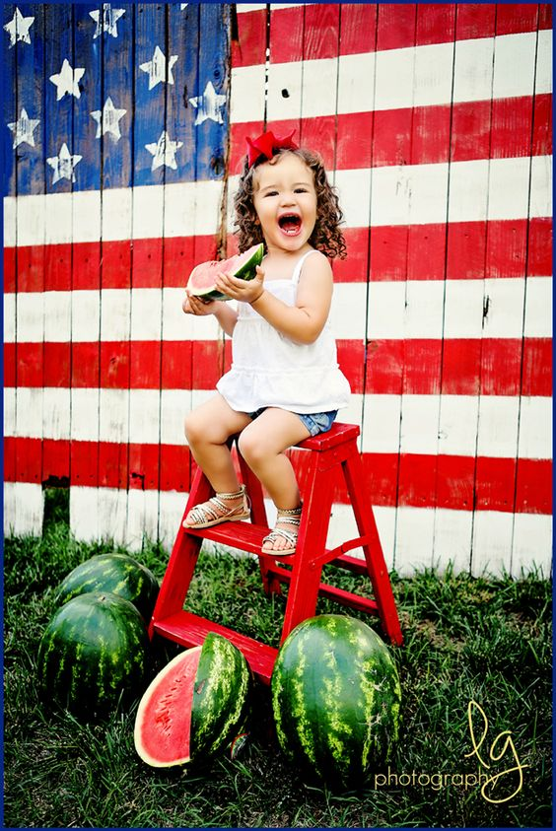
Examples of sets from Pinterest

Slide 8
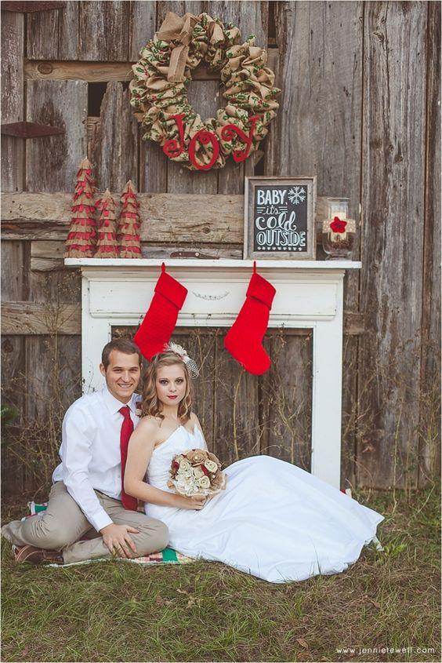

Slide 9
Photography Services
We also will also offer photography services. Wendy is earning a Professional Photography Certificate from New York Institute of Photography and will offer clients various photography services:
Photographer's Playground sessions
Senior Portraits
Bridal Portraits
Wedding Photography

Slide 10
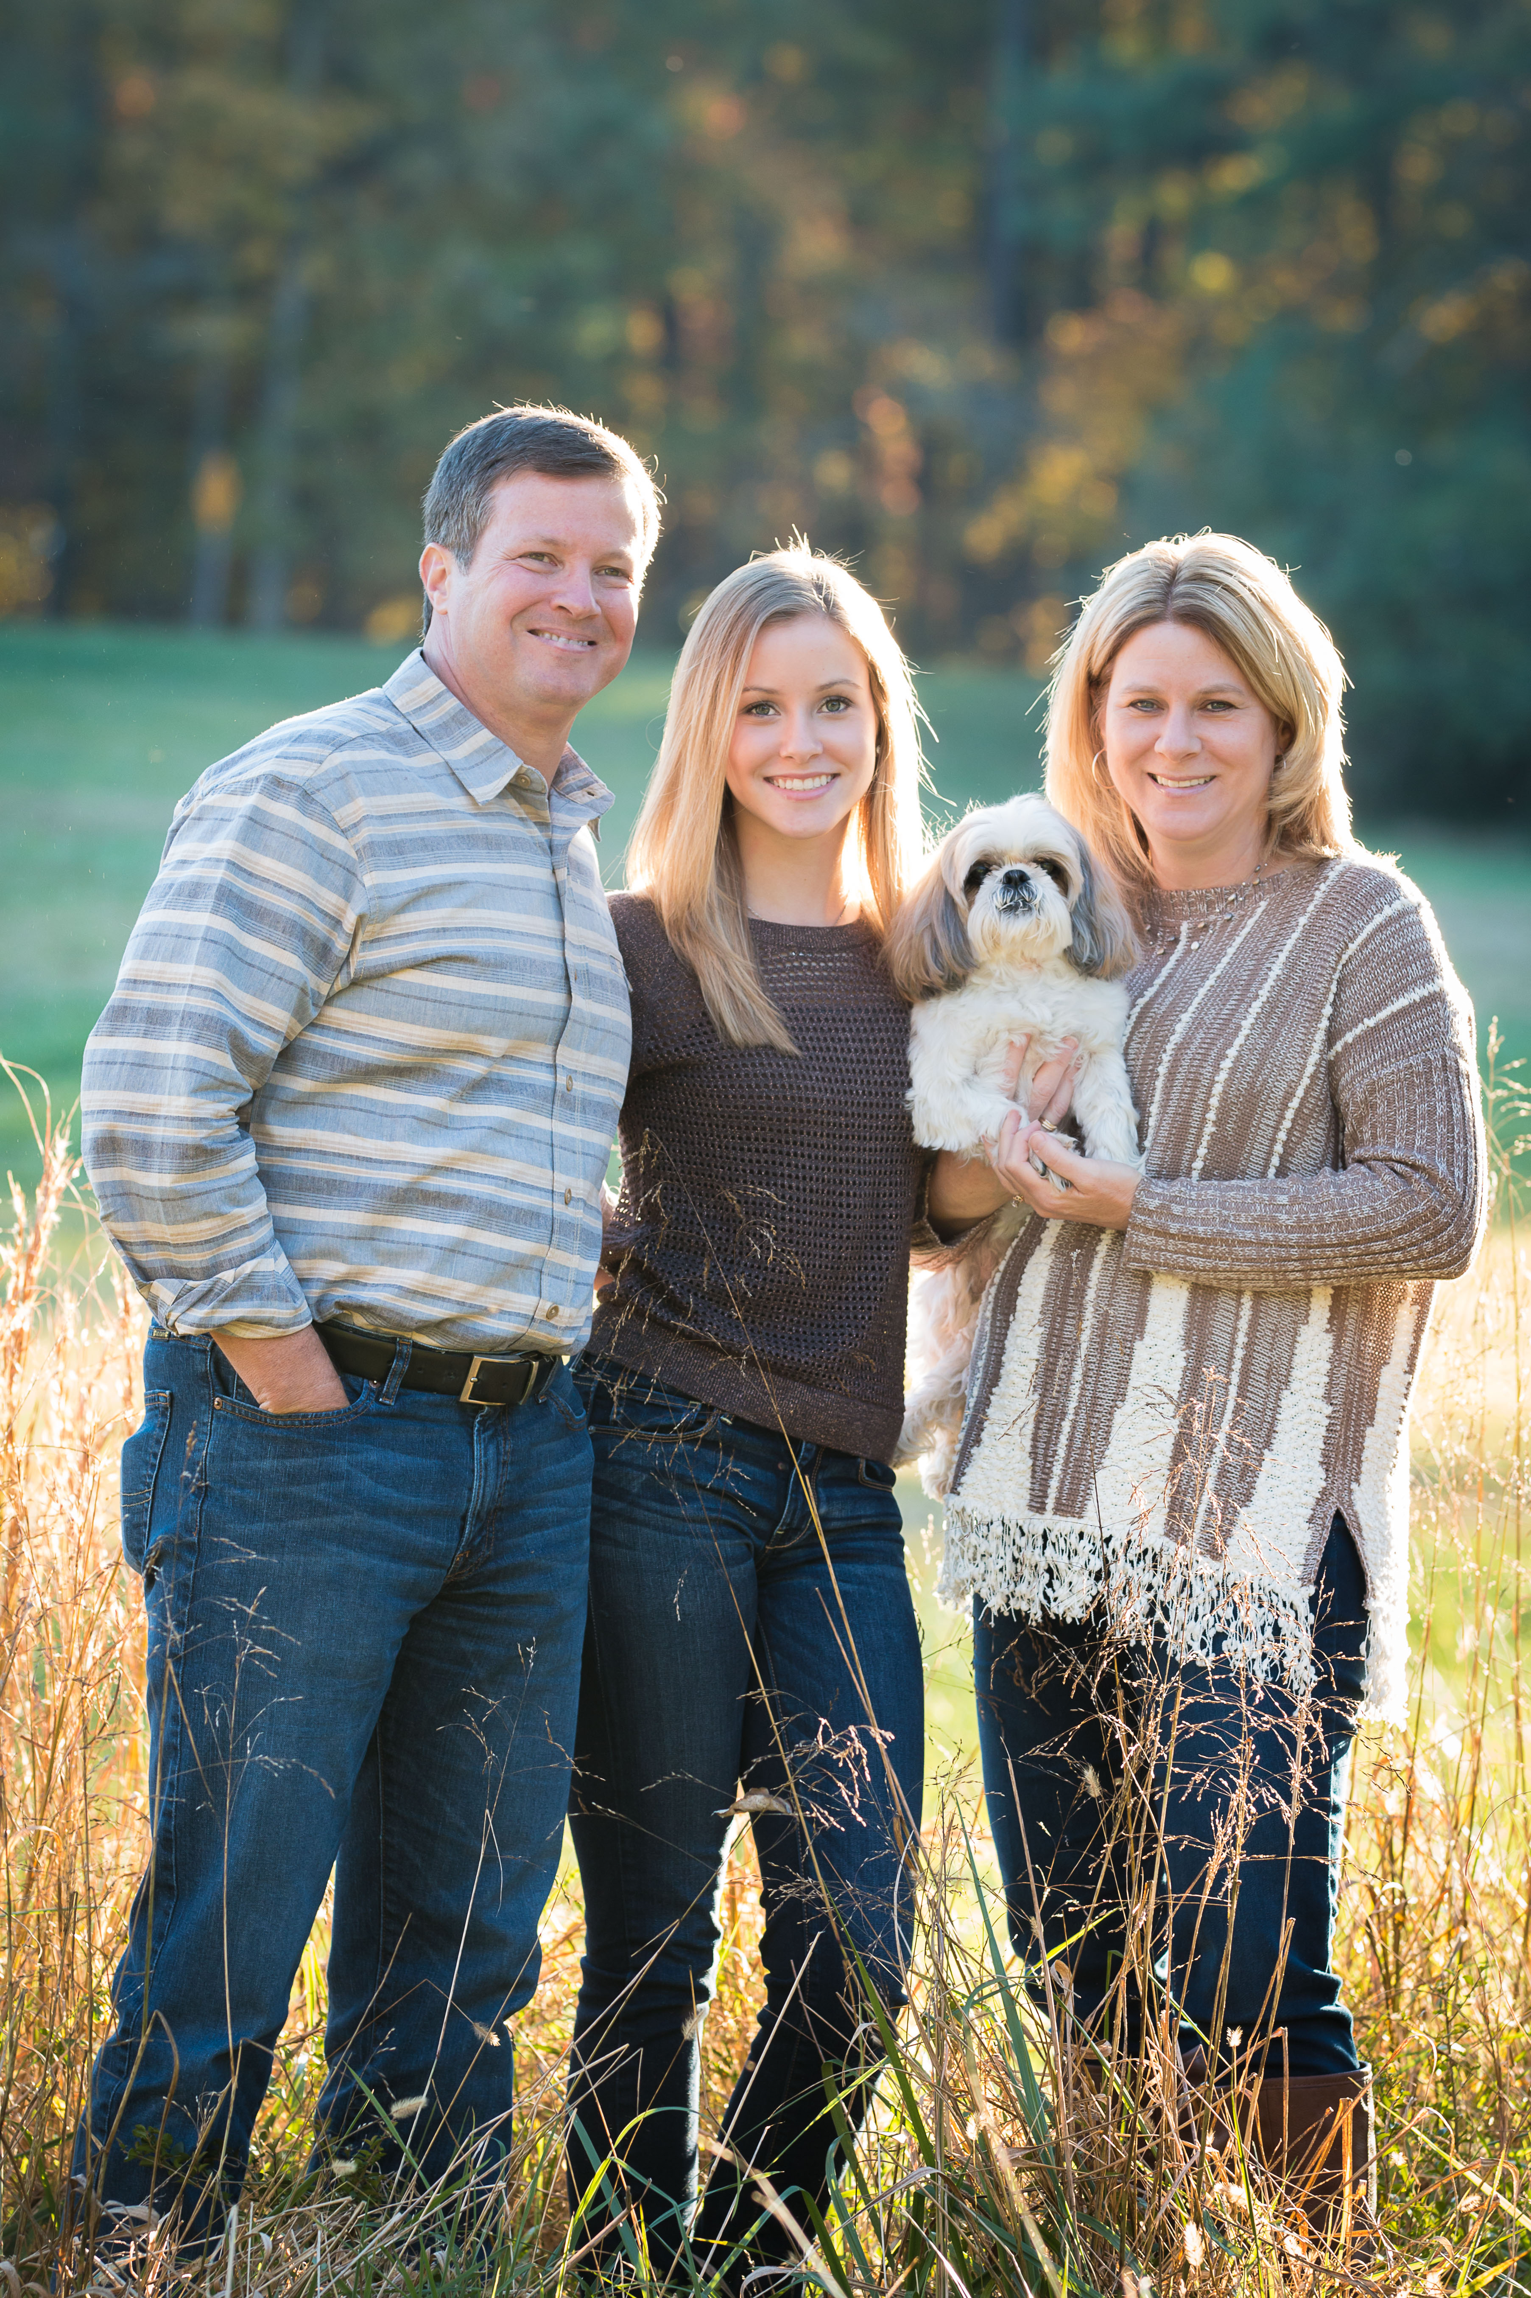
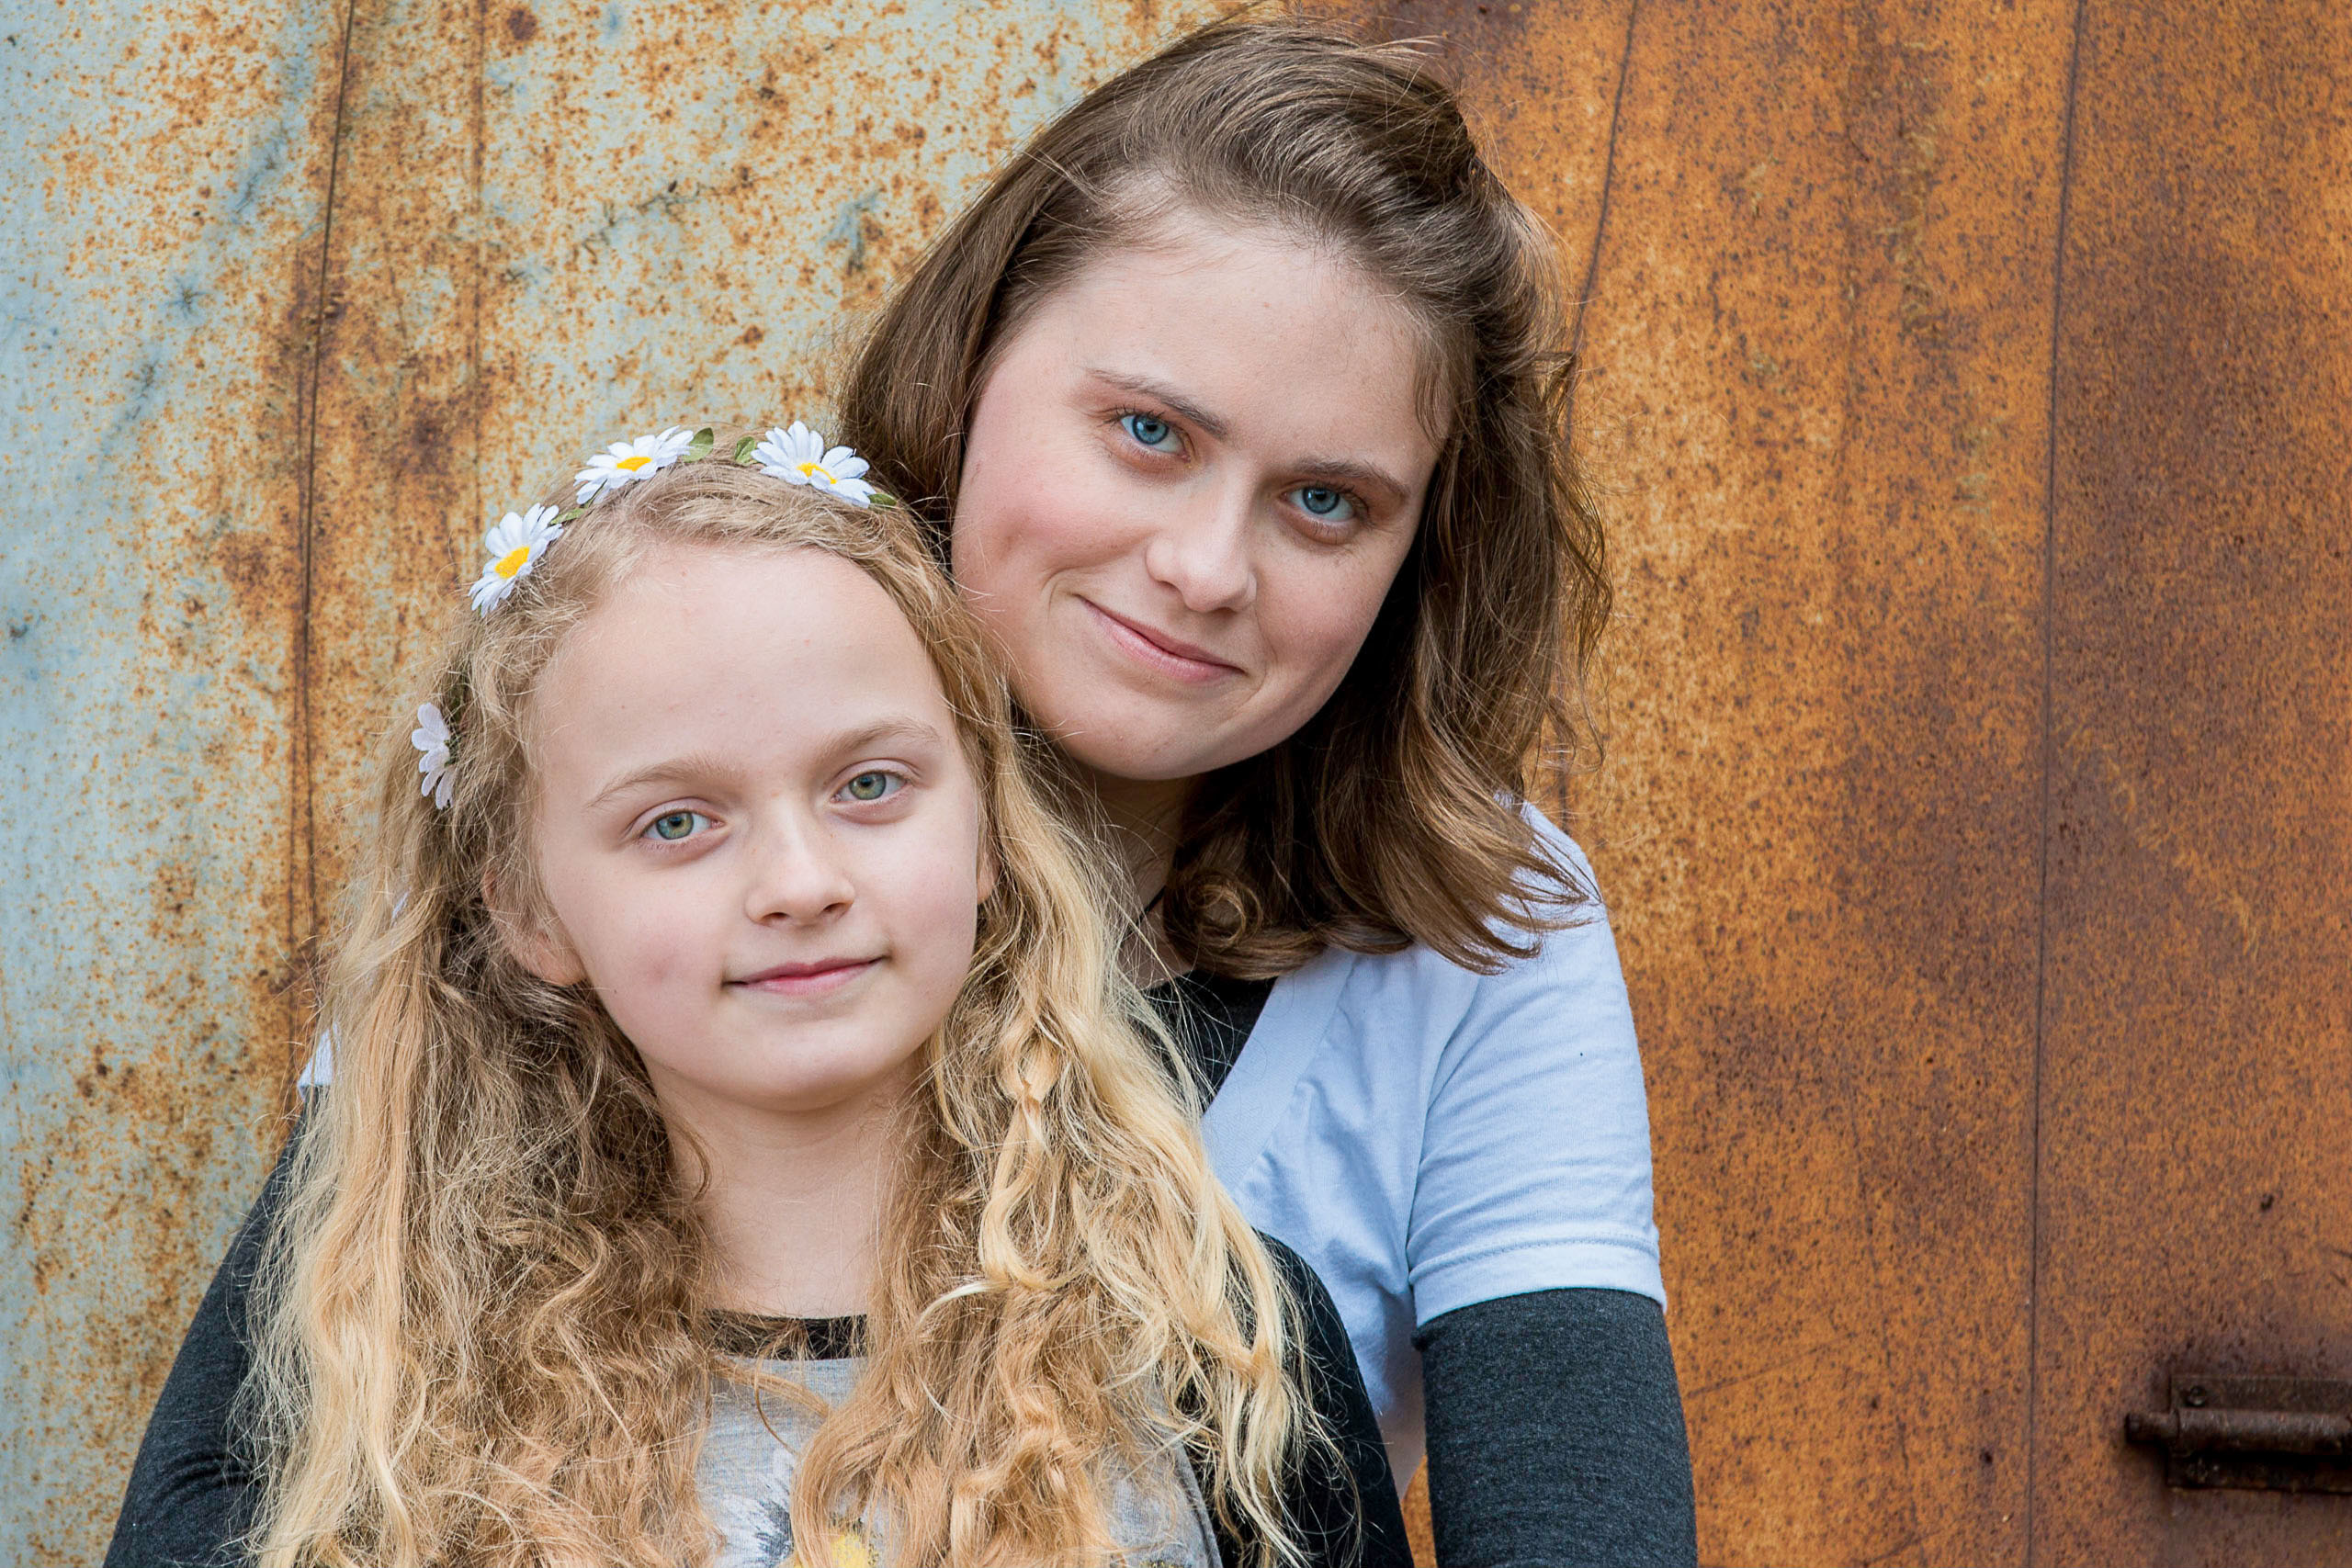
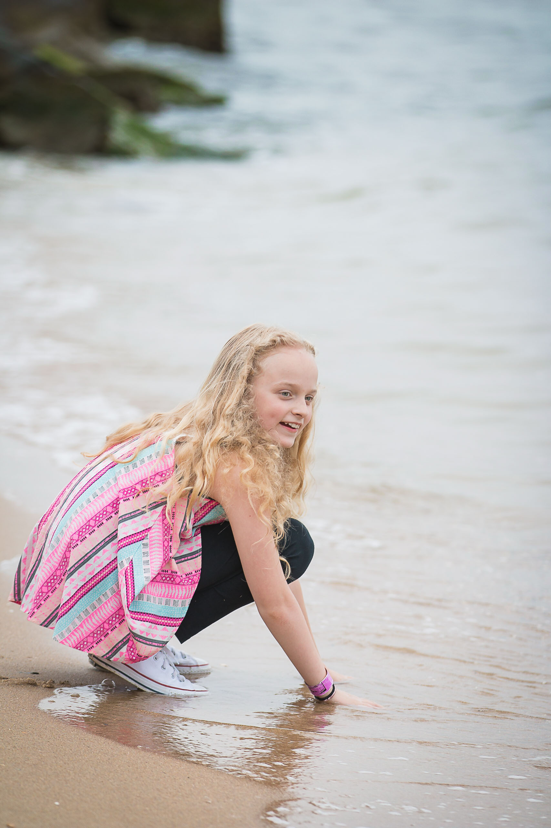

Slide 11
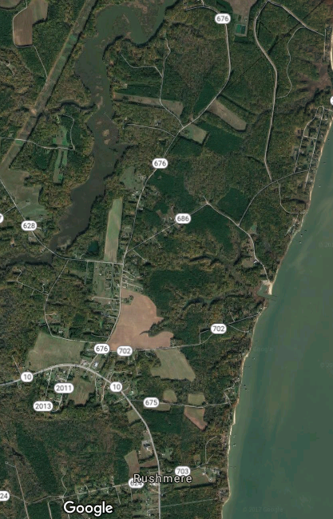
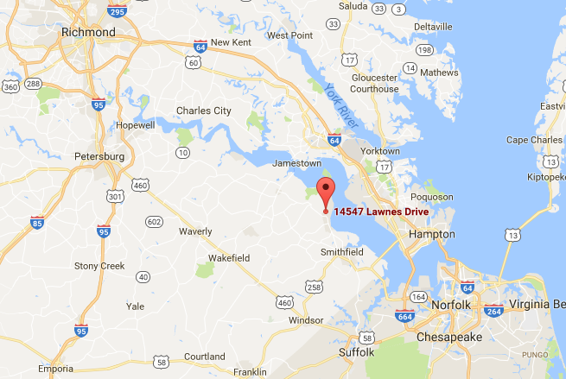
Location
14547 Lawnes Drive, Smithfield, VA

Slide 12
Localities within 1-½ hours of New Branch Farms
Smithfield – 12 min
Newport News – 42 min
Hampton – 43 min
Suffolk – 43 min
Yorktown – 45 min
Portsmouth – 47 min
Norfolk – 48 min
Chesapeake – 52 min
Poquoson – 53 min
Southampton County – 1 hr 3 min
James City County – 1 hr 4 min
Virginia Beach – 1 hr 5 min
Williamsburg – 1 hr 6 min
Petersburg – 1 hr 6 min
Gloucester – 1 hr 19 min
Richmond – 1 hr 20 min
Emporia – 1 hr 27 min
Mathews – 1 hr 30 min

Slide 13
Local Competition (Pricing is for Saturday Event)
Smithfield Center - $2,800 (additional charge for rehearsal and ceremony site)
Meadowbrook Farm - $3,600 (non climate controlled barn)
Women's Club of Portsmouth - $4,000
Events at Holly Ridge Manor - $4,500 (tent)
Fair Winds Farm - $4,500 (tent)
County Villa Inn - $5,699 (pavilion)

Slide 14
Regional Competition
Cousiac Manor - $4,900 (non climate controlled hall)
Bluestone Vineyard - $4,900
House Mountain Inn - $5,000
Montfair Resort Farm - $5,760
The Barn at Timber Creek - $6,000
The Foundry - $6,000

Slide 15
Regional Competition continued
Ashton Creek Vineyard - $6,500
Shadow Creek - $7,000
King Family Vineyards - $8,500
The Inn at Willow Grove - $7,000
The Mill at Fine Creek - $7,200
Pippen Hill - $10,500

Slide 16
Marketing Plan
Participate in local wedding trade shows
Face to Face meetings with local wedding planners, caterers, photographers, florists, and DJs
Advertise on Wedding Wire, The Knot, and My Wedding
Grand Opening Open House
Facebook, Twitter, Pinterest and other social media sites

Slide 17
Sales Plan
A $1,000 deposit and $500 refundable security deposit will be required to reserve the date with the balance due 60 days prior to the event.
If the event is cancelled before 90 days prior to the event, the $500 security deposit will be refunded but the $1,000 deposit will not.
If the event is cancelled within 90 days prior to the event and we are not able to rebook an event for that date, the result is the loss of the entire rental fee.
We will accept Cash/Check/Visa/MasterCard/American Express

Slide 18
Facilities
3,300 sq ft hall with open flooring, vaulted ceilings, wooden beams and a large stone fireplace
800 sq ft gathering area with bar and a stone corner fireplace with TV over mantel
Large Bridal Suite with private bathroom, vanity for 4, couch, large mirror, and a mini fridge.
Large Groom Room with couch, mini fridge and TV with XBOX
ADA Restrooms

Slide 19
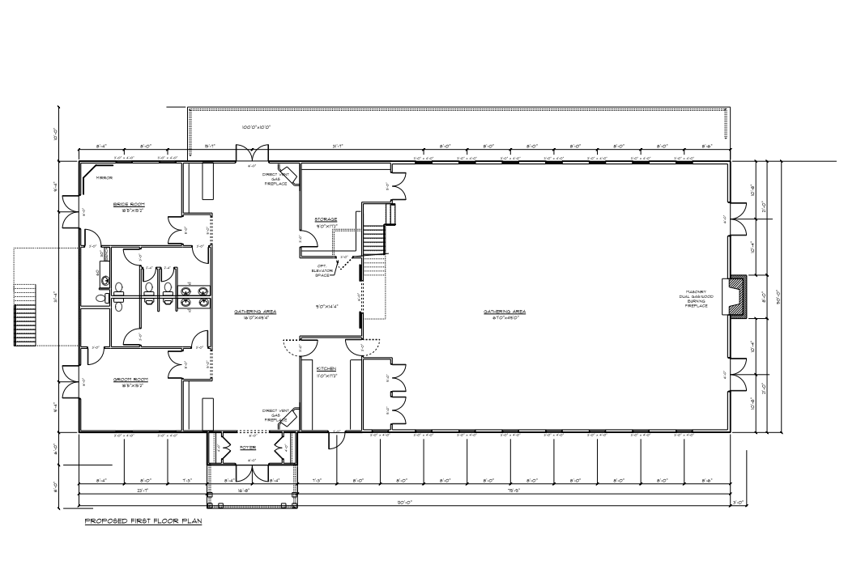

Slide 20
Living Area
The facility also has 2,800 sq ft of living area on the 2nd floor of the building including 2 bedrooms, 2 ½ bathrooms, laundry room, kitchen, dining area, living room and office.
This area is designed to be easily converted into a small venue area (for rehearsal dinners, bridal showers, baby showers, small gatherings) with separate nightly accommodations for the bridal party.

Slide 21
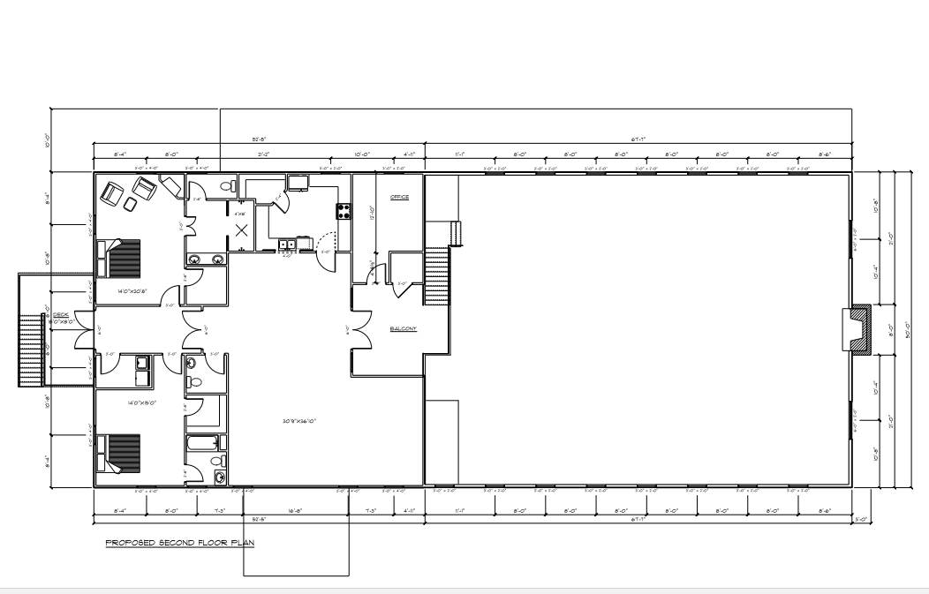

Slide 22
Technology
Large Screen TVs throughout facility to display photos and video
State of the art sound system
Wifi capabilities
Offer live streaming of the event

Slide 23
Landscape
Private courtyard off Bridal Suite and Groom Room with lush vegetation for first look and after the wedding photos
Wedding ceremony site with barn doors, benches, and a fireplace
Wedding ceremony site with gazebo
Wedding ceremony site with wooden arch
Fire pits and lawn games
Professionally manicured landscaping

Slide 24
Projected Milestones
Acquire Financing
Acquire Property
Erect Building
Install Landscaping
Open House
First Wedding/Event

Slide 25
Conclusion
New Branch Farms Event Venue is a solid investment opportunity. We are in search of 2 – 3 additional business partners who are as excited about this opportunity as we are.
If you would be interested in hearing more about New Branch Farms, do not hesitate to contact Sam Mills at (757)903-5953.
New Branch Farms Where Rustic Meets Elegance and Generations Begin

